Slide 1

Time to Take Off
Olivia Fenwick and Meenu Ravi

Slide 2
Agenda
Project overview
Considerations and Concerns
Final output
Next Steps

Slide 3
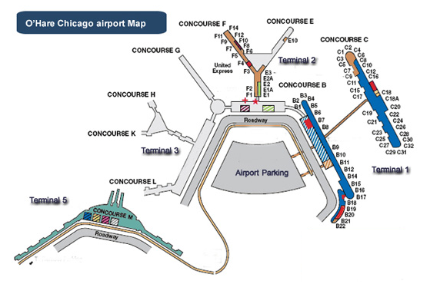
We created a model to simulate gate reassignment for delayed flights
Project Overview
If a flight is delayed and its scheduled gate is unavailable at the new arrival/departure time our model automatically finds the closest available gate and reassigns it
We used United Airlines schedule data to initiate the model and used a random number generator to created delays in real-time
Image source: http://www.airport-chicago.com/map-of-ohare.htm
Notes:
The United airlines schedule data was provided as csv file with information regarding the flight number, arrival time departure time gate info and locations
Schedule data organise with line of flight information with schedule information for plane arriving at chosen airport (e.g. ORD) and leaving that airport

Slide 4
Project Goals
Project Overview
Initial Goals
Target Goals
Stretch Goals
Initiate model to on small airport
Richmond International Airport ~15 flights per day
Get model working on large airport
O’Hare International Airport ~555 flights per day
Create dynamic departure/arrivals board
Make delays more dynamic and have delay length be randomly updating instead of static
Initiate model with static delay lengths
Use minimum turn time to have different delay lengths for arriving and departing flights
Display the flight changes in a dataframe representing a departure/arrivals board

Slide 5
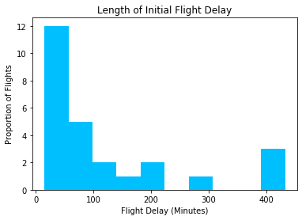
Considerations
Considerations and Concerns
Data pre-processing and formatting
Especially working with datetime we had to ensure everything was consistent
Create an arrivals/departure board to show flight status/gate assignment changing over time
Randomly generated delays using a random number generate to simulate real-time delays
5% - 10% of flights delayed
Delay length skewed to shorter delays
Notes:
Delays – how to make it realistic

Slide 6
Concerns and Mitigations
Considerations and Concerns
How to get the simulation to run in real-time
SimPy library – Python’s discrete-event simulation library
Each run of the code to represent one minute of the day
Speed and performance
Complexity of algorithms
Eliminate duplicity of code
Adjusting for unexpected airline scenarios
Tried to handle rationally as an airline would but within the limitations of our model
For example if a delay pushed a flight into the next day we chose to cancel that flight
Notes:
Simpy
Real-time setting so we could say 1 minutes = 0.2 seconds
Caused some issues where our code wasn’t as efficient as we would’ve liked - it would error out if the code took longer than 0.2 seconds to run
Speed and performance
Rework functions to make more efficient
Unexpected airline scenarios:
What happens if there’s no gates available at that time?
What if a flight delay pushes a flight into the next day?
What to do with the flights that arrive and leave on different days?

Slide 7

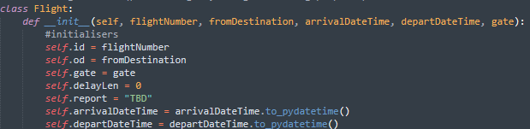
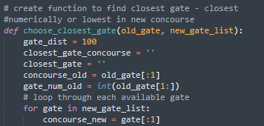

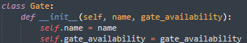


Flying into the Code
Final Output
Click to View Full Code
1
Two Main Classes to store flight info and gate availability
3
When a delay cause a gate collision, reassign flight to new gate
Simulate relocation and reassignment using Simpy in a 24 hour clock
View a 24 hr Arrival Schedule
Choose when a flight gets delayed and for how long randomly
2
4

Slide 8

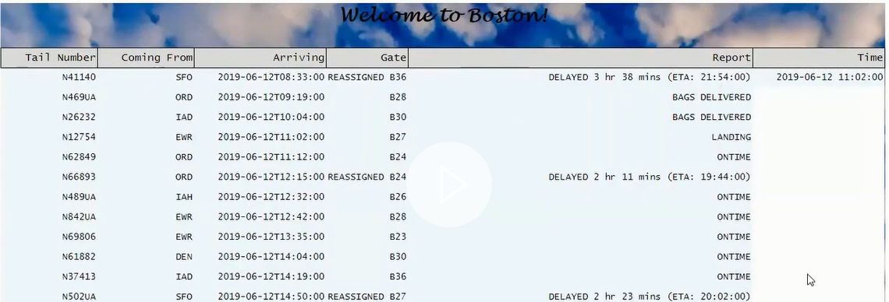
Demonstration
Final Output
View here Also: https://www.youtube.com/watch?v=hZ2jl5msfaA

Slide 9
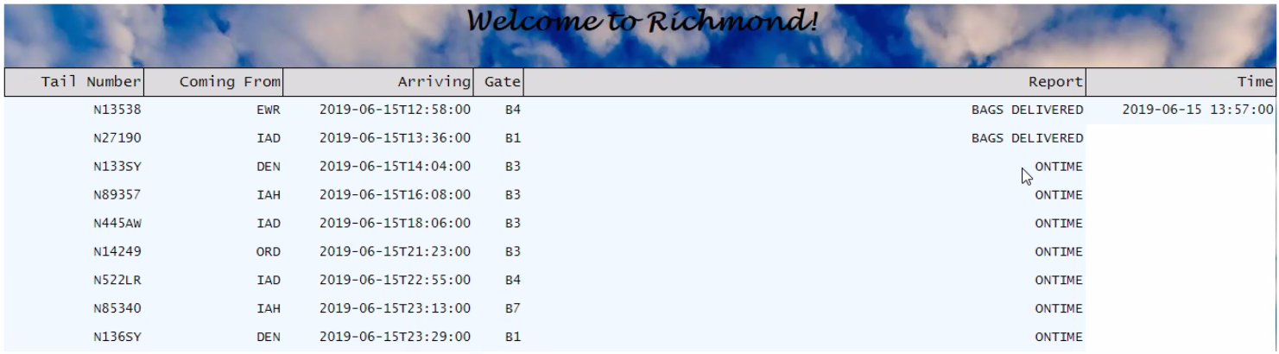
Next Steps
Next Steps
Currently the departure and arrival boards have to be run separately
Threads would allow them to update simultaneously
Use minimum turn time to have different delay lengths for arriving and departing flights
Make flight delays more realistic
Try to incorporate weather data to predict and simulate how weather can affect delays at varying locations

Slide 10
Any questions?

